Slide 1
Teaching novice programmers
Todd Iverson
Winona State University
https://tinyurl.com/yckaex7t

Slide 2
More information at https://tinyurl.com/yckaex7t
These slides
Additional slides for talks on
Clean Code
Refactoring Code & Unit Tests
Teaching with Data Verbs

Slide 3
Outline
Some first principles
Why coding should come much later in the first course
A few more first principles (as time permits)

Slide 4
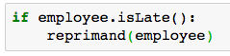
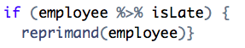
First Principle #1 Code should read like prose
Any fool can write code that a computer can understand.
Good programmers write code that humans can understand.
Martin Fowler
Notes:
Doug looks over his notes.
(click) So data should say what it is
(click) and functions should say what they do.

Slide 5
First Principle #2 Don’t worry about speed
The real problem is that programmers have spent far too much time worrying about efficiency in the wrong places and at the wrong times; premature optimization is the root of all evil (or at least most of it) in programming.
- Donald Knuth
Notes:
Doug looks over his notes.
(click) So data should say what it is
(click) and functions should say what they do.

Slide 6
Outline
Some first principles
Why coding should come much later in the first course
A few more first principles (as time permits)

Slide 7
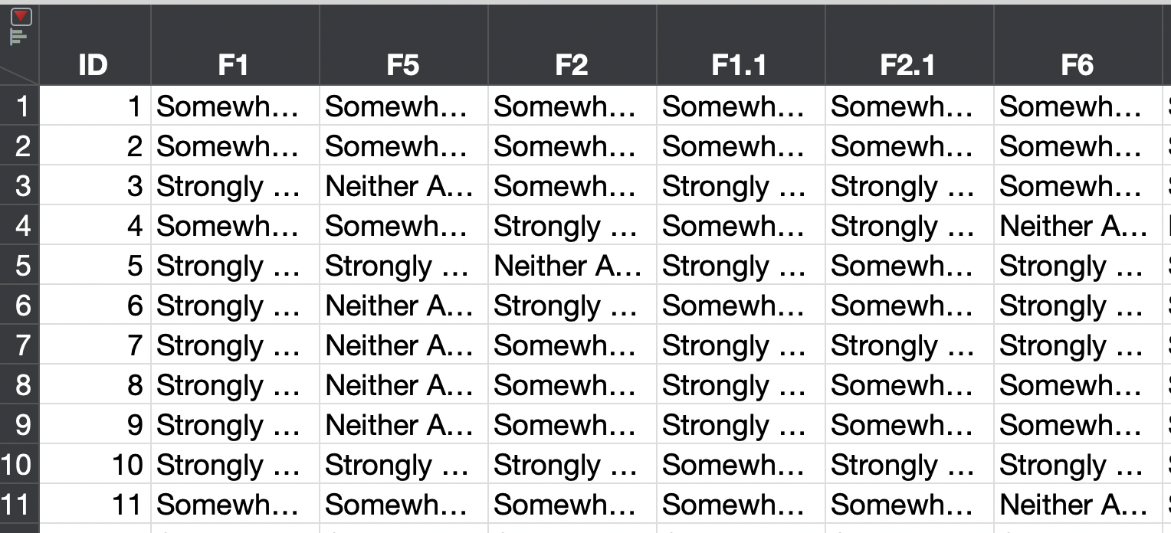
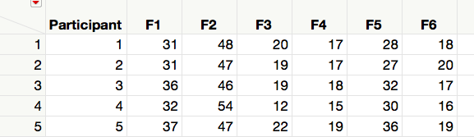
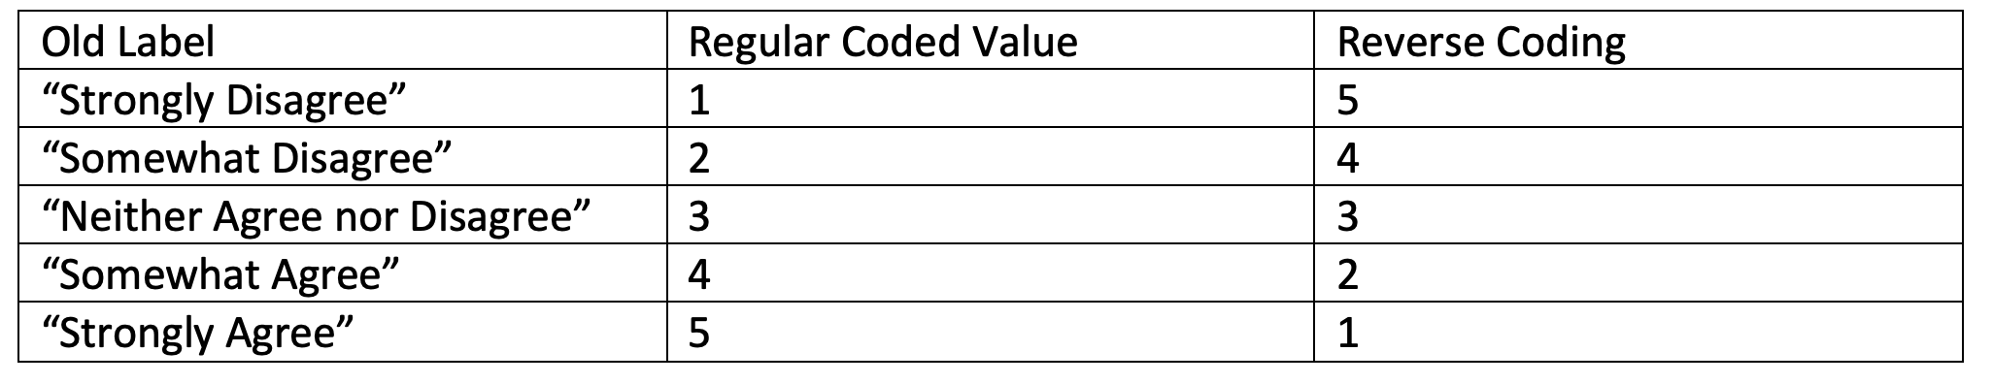
Problem 1 Summarize a health survey

Slide 8
Doug is struggling!
What should I do first? Second?
What functions should I use?
How do I make my code run/correct?

Slide 9
Doug is struggling!
Algorithm
Step-by-step process
What should I do first? Second?
What functions should I use?
How do I make my code run/correct?

Slide 10
Doug is struggling!
Algorithm
Step-by-step process
What should I do first? Second?
Implementation
Which libraries/functions
What functions should I use?
How do I make my code run/correct?

Slide 11
Doug is struggling!
Algorithm
Step-by-step process
What should I do first? Second?
Implementation
Which libraries/functions
What functions should I use?
Correct Code
Avoid bugs and verify correct results
How do I make my code run/correct?

Slide 12
We decouple the algorithm and the code!
Notes:
Then just in the nick of time …

Slide 13
The algorithm is most important Let’s make sure Doug is proficient here first!
Algorithm
Step-by-step process
Start here!
What should I do first? Second?
Implementation
Which libraries/functions
What functions should I use?
Correct Code
Avoid bugs and verify correct results
How do I make my code run/correct?

Slide 14
Goal. Algorithms before code Step 1- Sketch the solution using data verbs
T1
T2
Task
G | X
a | 5
a | 2
b | 3
b | 1
G | Y
a | 3
a | 2
b | 4
b | 1
b | 1
????
G1 | Sum(X) | Sum(Y)
a | 7 | 5
b | 4 | 6
T1
T1
G | X
a | 5
a | 2
b | 3
b | 1
GROUPBY
G
G | X
a | 5
a | 2
b | 3
b | 1
T1
AGGREGATE
SUM(X)
G | X
a | 7
b | 4
JOIN BY
T1.G == T2.G
SELECT
G1, X, Y
G1 | X | G2 | Y
a | 7 | a | 5
b | 4 | b | 6
G1 | X | Y
a | 7 | 5
b | 4 | 6
T2
T2
G | Y
a | 3
a | 2
b | 4
b | 1
b | 1
GROUPBY
G
G | Y
a | 3
a | 2
b | 4
b | 1
b | 1
AGGREGATE
SUM(X)
T2
G | Y
a | 5
b | 6

Slide 15
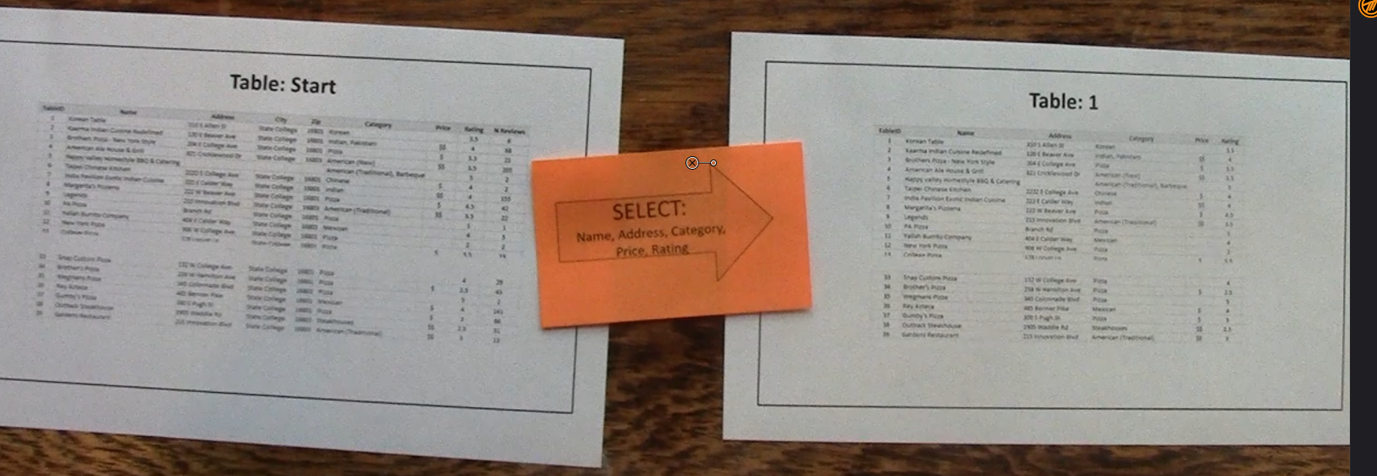
This step can be very low tech …

Slide 16
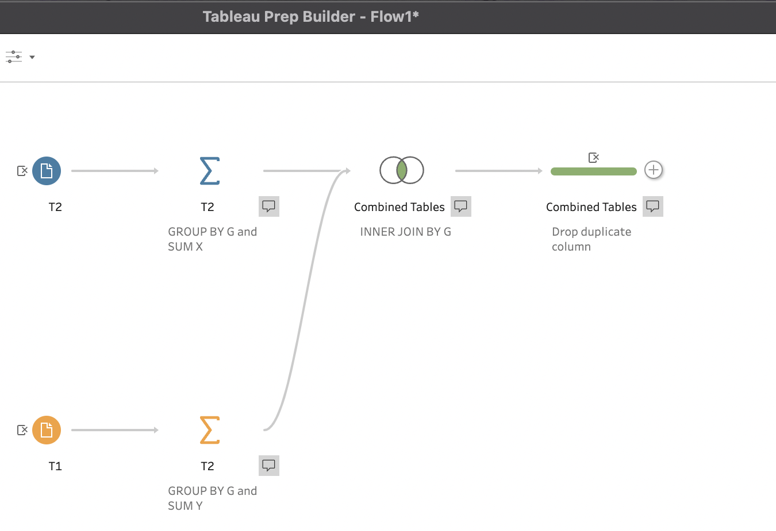
Goal. Algorithms before code Step 2 – Implement in a low-code environment
All drag and drop in Tableau Prep

Slide 17
What is a low code solution?
Most tasks → Menus
Some access to formulae when needed
Examples
Excel
And maybe PowerBI?
Tableau Prep
Alteryx
Open Refine

Slide 18
Problem 1 Summarize a health survey

Slide 19
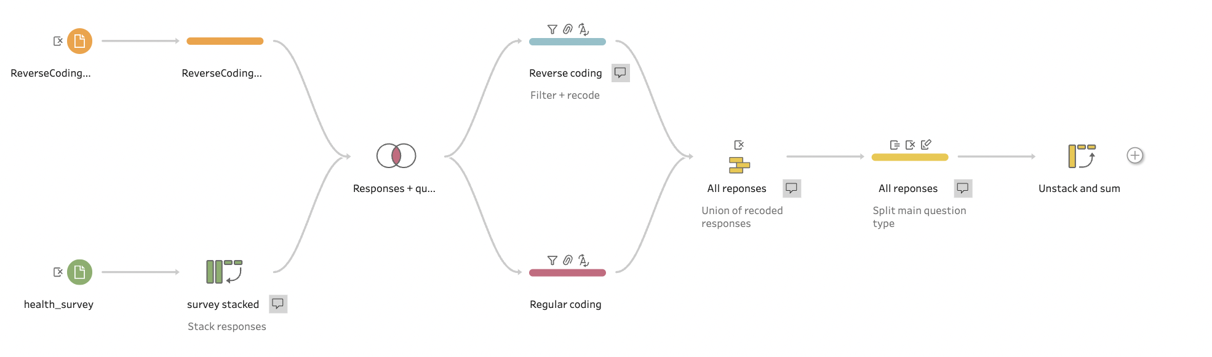
No code solution in Tableau Prep
Bifurcate + filter replaces an IF

Slide 20
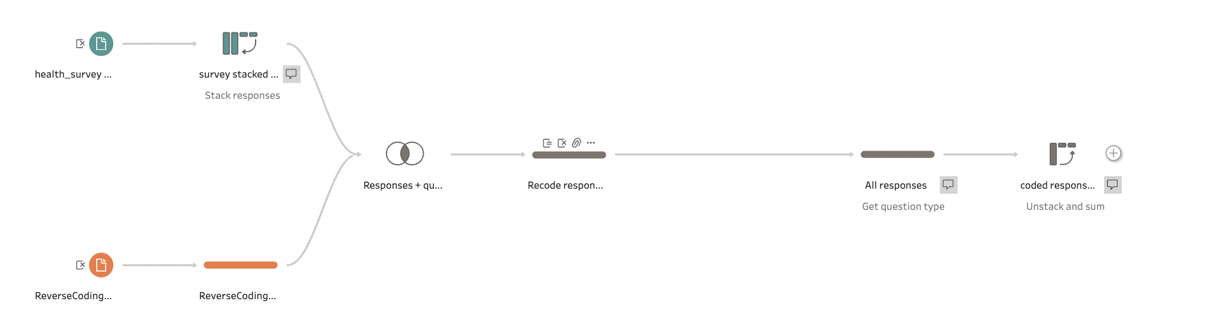
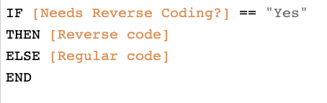
Low code solution

Slide 21
Outline for DSCI 210
Low Code
Scripting + Low Code
Intro to Tidy Data
Aggregation
Data Verbs
Intro to Visualization
Classification and CART
String Verbs and Window Functions
Managing data with R/tidyverse
Reshaping tables
Table joins
Intro to Arules

Slide 22
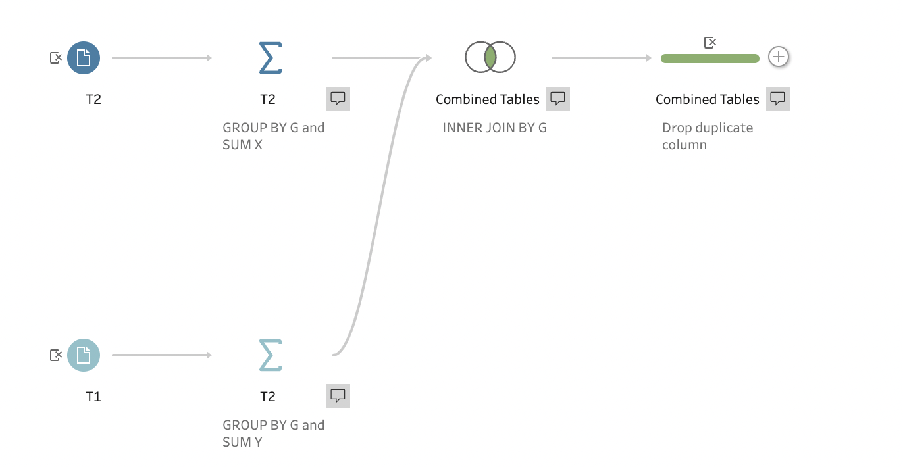
Goal. Implement the algorithm Step 1 – Identify the correct tools
read.csv
group_by
+ summarise
inner_join
select

Slide 23
Goal. Implement the algorithm Step 2 – Implement each step while checking the results

Slide 24
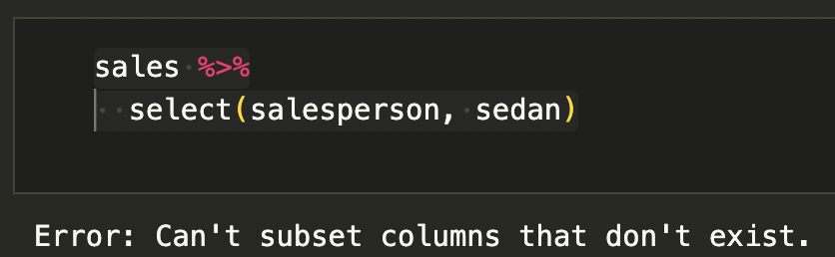
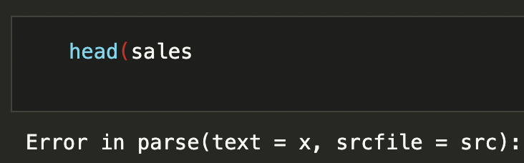
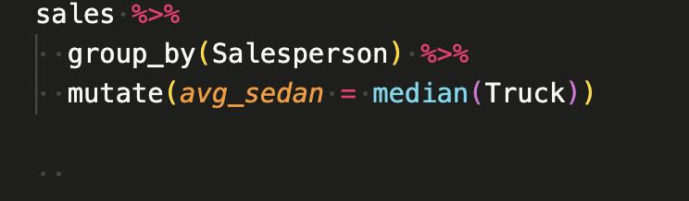
Goal. Write correct code Three types of errors
Name Errors
Using the wrong name
Syntax Errors
Incorrect syntax
Sematic Errors
Code runs, wrong results
Covered Dr. Chris Malone in his talk on Tuesday @ 2pm.

Slide 25
Outline
Some first principles
Why coding should come much later in the course
A few more first principles (as time permits)

Slide 26
First Principle #2.5 Library and file format impact speed
Investigate
Parquet files
Lazy evaluation
polars
spark
We spend our time loading data, and clever R/Python code doesn’t make the data load faster without the right library.
- Todd Iverson
Notes:
Doug looks over his notes.
(click) So data should say what it is
(click) and functions should say what they do.

Slide 27
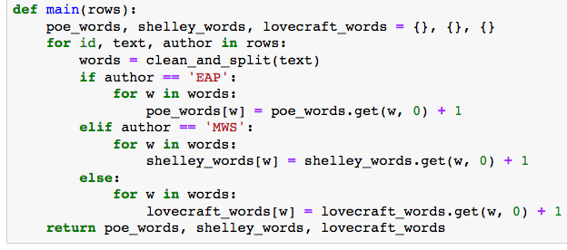
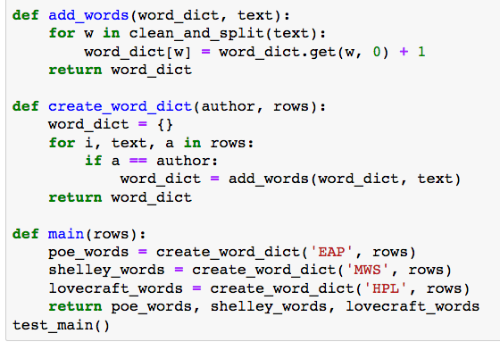
First Principle #3 Organize your code using small, reusable functions
Investigate
Test driven design
Refactoring
Unit test
Investigate
Parquet files
Lazy evaluation
polars
spark
Refactored into small functions
Nesting
→ Function is doing too much
Notes:
Doug looks over his notes.
(click) So data should say what it is
(click) and functions should say what they do.

Slide 28
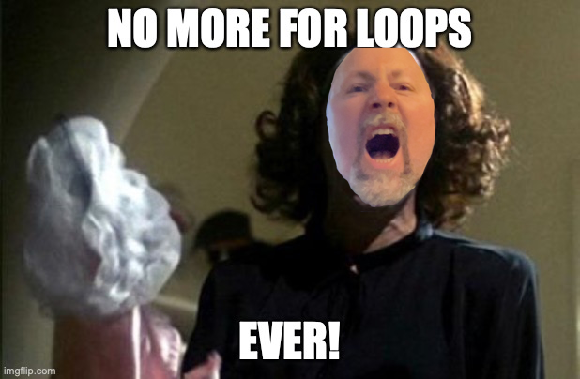
First Principle #4 PLEASE retire loops like the GO TO statement
Investigate
Map, filter, reduce
purrr library (R)
Comprehensions & iterators (Python)
Notes:
Doug looks over his notes.
(click) So data should say what it is
(click) and functions should say what they do.

